Slide 1
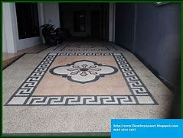
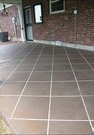
Basic flooring finishing.
1.Carpets
-Advantages : 1. It is inexpensive. 2. It is soft.
-Disadvantages : 1. It holds dust. 2. It is difficult to clean.
2. Ceramic tiles
-Advantages : 1. Durable 2. Easier to clean.
-Disadvantages : 1. Cold surfaces. 2. Uncomfortable.

Slide 2
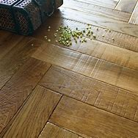
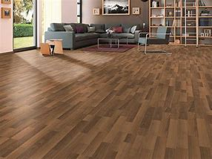
3.Solid wood floors
-Advantages : 1. Easy maintenance. 2.Long term investment.
-Disadvantages : 1. It is expensive 2. Scratching.
4.Laminate floors
-Advantages : 1.Resistant to stains. 2. Resistant to fading.
-Disadvantages : 1. Prone to water damage. 2. warping if installed improperly.

Slide 3
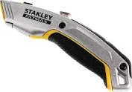
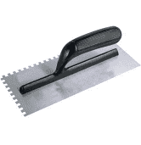
Basic flooring tools.
1.Stanley knives
- It is used for cutting all types of vinyl and linoleum floor coverings.
2.Trowels
- It is used for cleaning surfaces and exposing new levels.

Slide 4
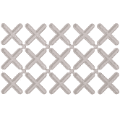
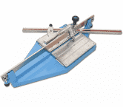
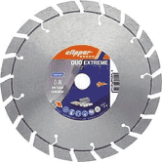
3.Spacers
- It is used to maintain a consistent. Space between tiles
4.Tile cutters
- It is used for cutting ceramic tiles.
5. Cutting edges
-It is used for cutting ceramic tiles.

Slide 5
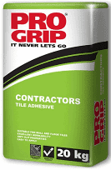
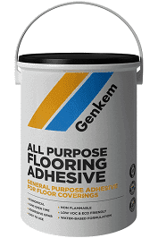
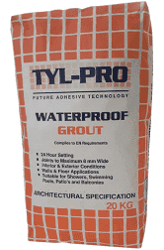
Basic flooring materials
1.Tile cements
- It is used as an adhesive.
2.Glue
- It is used as an adhesive.
3.Grouts
- It is used to fill up the gaps between tiles.
- Video : https://youtu.be/FkQeQHRBbhQ?si=dNH3d99kbtWnz1sd

Slide 6
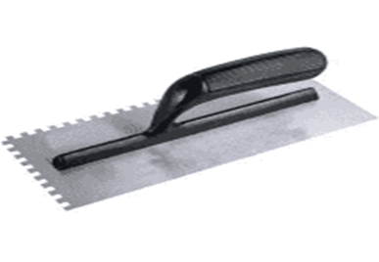
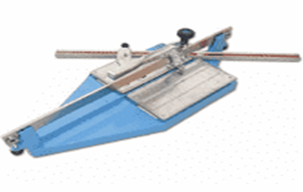
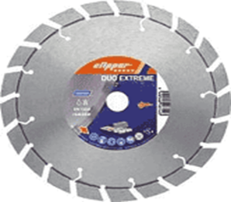
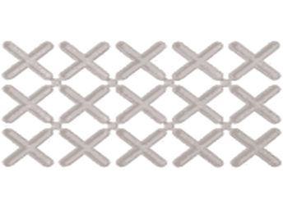
Kwa Thema Skills School
Subject : Maintenance Marks : 12
Grade : Year 1 Time : 30 mins
Date : / / 2024
Question:1
1.Name the following flooring tools.
1.1.__________________ 1.2.______________________
1.3.___________________ 1.4. ______________________

Slide 7
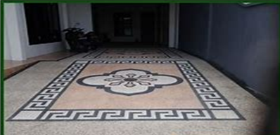

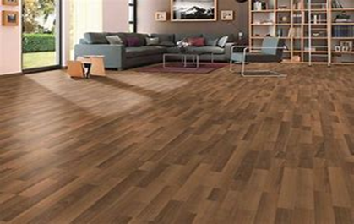
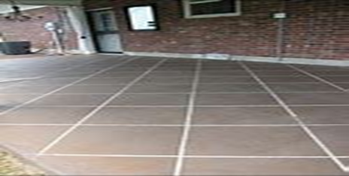
2. Name one advantage and disadvantage of the following flooring finishing shown below:
Carpet Solid wood floor
Advantage Advantage
1. ________________________________ 1. _____________________________________
Disadvantage Disadvantage
1. ________________________________ 1. ______________________________________
Laminate floor Ceramic tiles
Advantage Advantage
1. ________________________________ 1. _____________________________________
Disadvantage Disadvantage
1. ________________________________ 1. _____________________________________
(12)

Slide 8
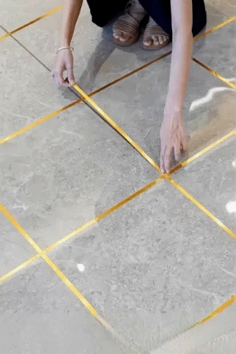
Feedback : Activity
(Practical lesson or Project)
Floor Tiling

